Slide 1


HOMEWORK #10
4 individual stocks plus QQQ as a market proxy
Assignment: Identify a stock (superleader) that will outperform all other stocks
www.WyckoffAnalytics.com Copyright © 2019 Wyckoff Associates, LLC. All Rights Reserved.

Slide 2
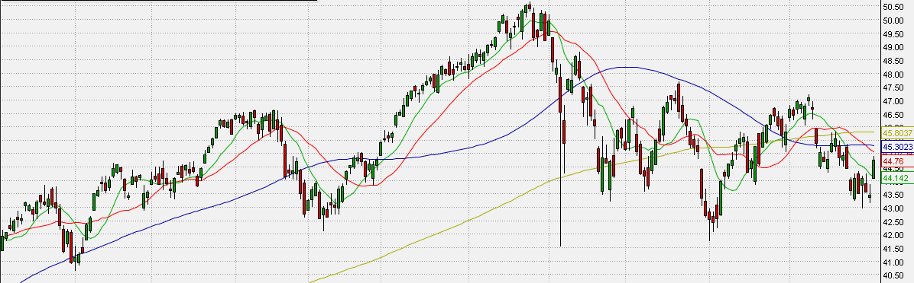
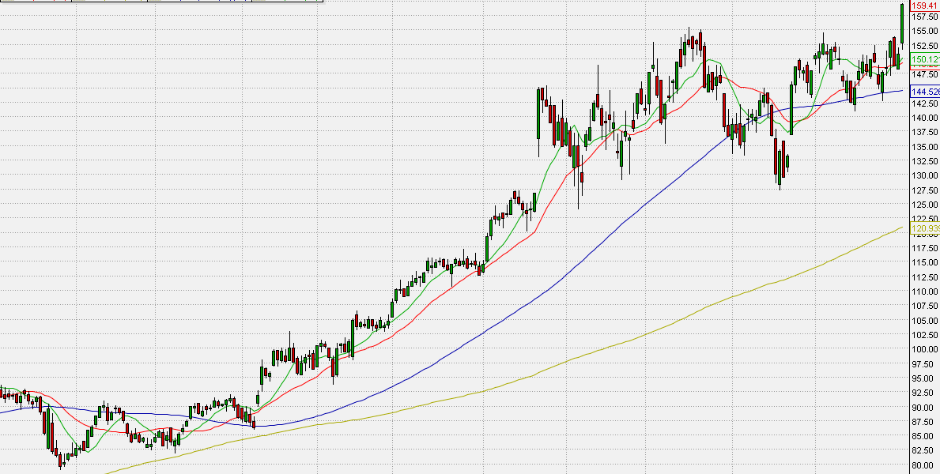
QQQ, Daily
Stock #1
www.WyckoffAnalytics.com Copyright © 2019 Wyckoff Associates, LLC. All Rights Reserved.

Slide 3
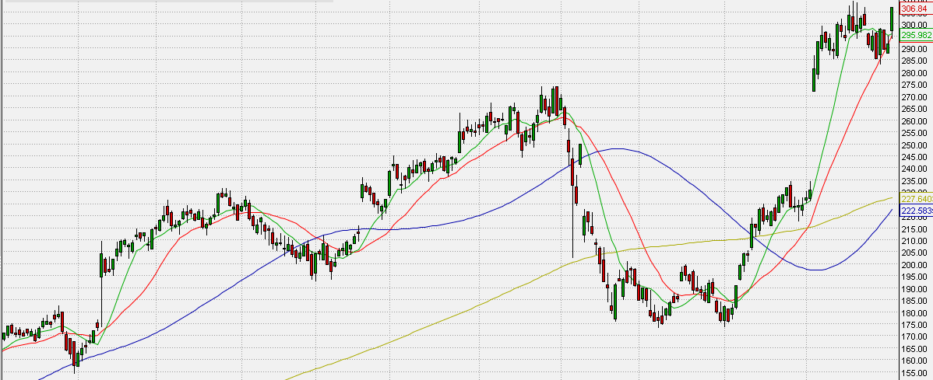
QQQ, Daily
Stock #2
www.WyckoffAnalytics.com Copyright © 2019 Wyckoff Associates, LLC. All Rights Reserved.

Slide 4
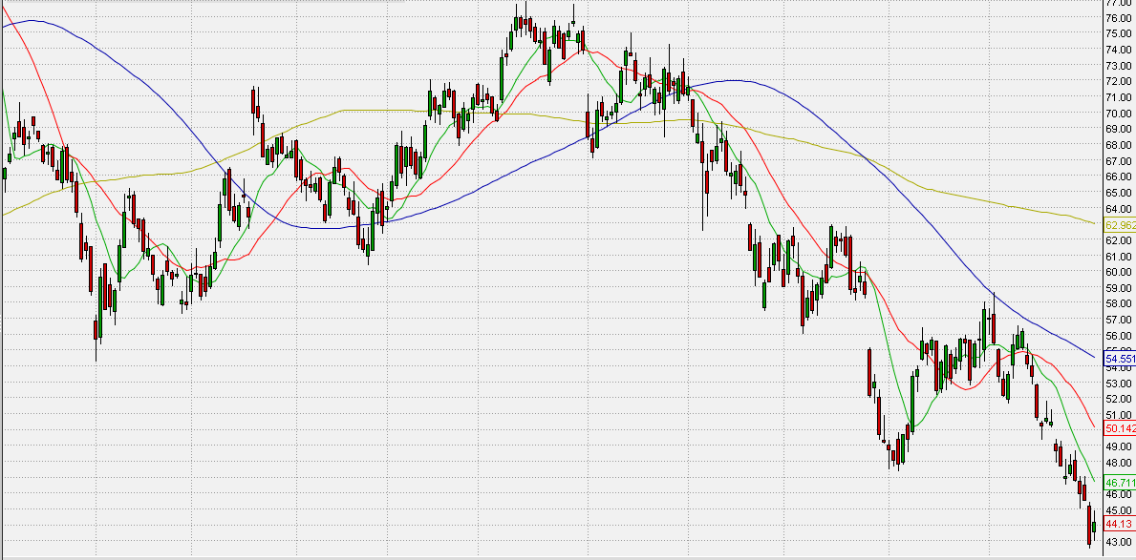
QQQ, Daily
Stock #3
www.WyckoffAnalytics.com Copyright © 2019 Wyckoff Associates, LLC. All Rights Reserved.

Slide 5
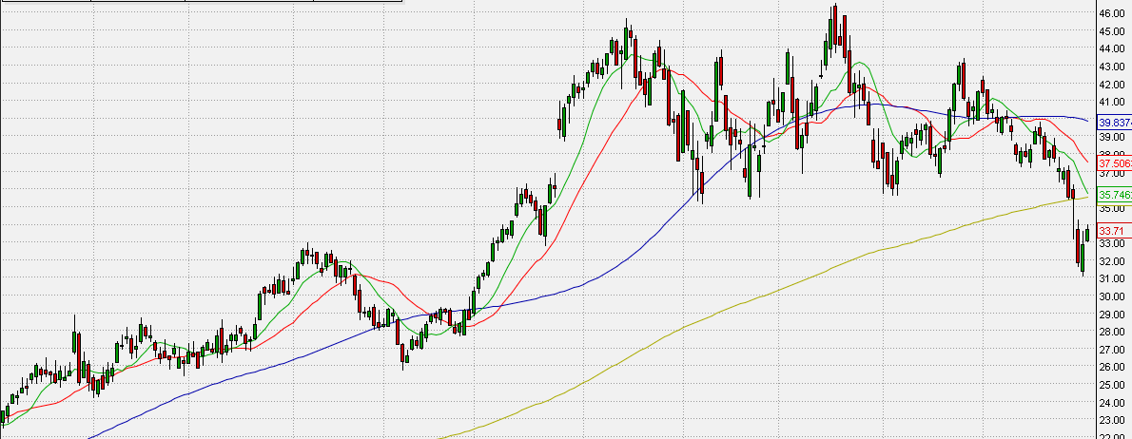
QQQ, Daily
Stock #4
www.WyckoffAnalytics.com Copyright © 2019 Wyckoff Associates, LLC. All Rights Reserved.

Slide 6
Comparison of all 4 stocks
Stock #1
Stock #2
Stock #3
Stock #4
www.WyckoffAnalytics.com Copyright © 2019 Wyckoff Associates, LLC. All Rights Reserved.

